Slide 1
Microsoft Movie studio
Yvonne Mwangi
Phase 1 Project
February 2024

Slide 2
Summary
Average annual revenue of $ 1.58B
Average number of movies produced per year – 173
The Avengers movies was both highly rated and generated high revenue
Anthony Russo is a highly rated producer whose movies are profitable
The revenue and profitability of movies are positively correlated
The production budget does not have a linear relationship with the profitability of the movie
A higher rating does not necessarily translate to a higher revenue however more movies with a higher revenue had a rating of 6 and above
Adventure and Drama movie genres are popular
Anthony Russo is a highly rated director and he produces successful movies. He would be a great choice for Microsoft

Slide 3

Agenda
1.
Business Problem
2.
Data
3.
4.
Methods & Results
Conclusuion

Slide 4
Introduction – Business Problem
Microsoft have decided to create a new movie studio.
I have been charged with exploring what types of films are currently doing the best at the box office.
My task is to translate those findings into actionable insights that the head of Microsoft's new movie studio can use to help decide what type of films to create.

Slide 5
Data Characteristics
Accuracy
The data is from reliable sources and we can therefore trust the accuracy of the data
Completeness
The data is comprehensive for the analysis
Reliability
Relevance
The data is from reliable sources (Box Office Mojo, IMDB, Rotten Tomatoes, TheMovieDB and The Numbers)
Timeliness
The data provided is relevant for the analysis
The data does not contain information after 2019, given that movie tastes change, this will not be taken into account in this nalaysis

Slide 6
Data Analysis - Data set limitations
Pros
Sufficiently large data sets
Varied information to allow various analysis
Cons
A great number of duplicates due after merging tables
Missing data in some of the data sets.
Discrepancies in some of the data sets for instance finding a movie with two different tconst ids

Slide 7
Data Methods
Checking for duplicates, missing data and Identified outliers
calculated summary statistics
visualization data distributions
Explored relationships between variables,

Slide 8
Results - Descriptive statistics
The data set contains movies created between 2010 and 2019.
The average length of the movies is 105 minutes. The longest movie is 192 minutes.
The average rating of these movies is 6.4. The lowest rating is 1.6 while the highest rating is 9.2.
The average budget for production of the movies is USD 4.66M. The lowest budget is USD 100000, while highest bud get is USD 3.79M
The average revenue for the movies is USD 1.58B . There are movies that did not generate revenue , while the one with the highest revenue is USD 2.04B

Slide 9
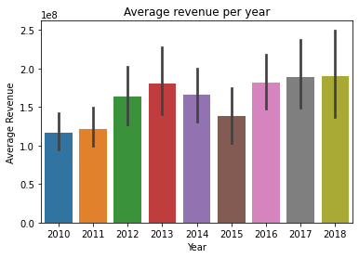
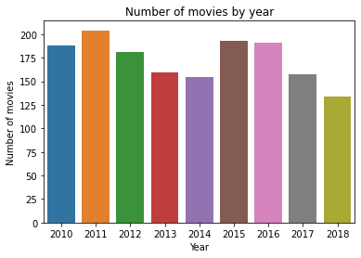
Results – Revenue and Number of movies
Average Annual revenue $ 1.58B
Average number of movies per year – 173

Slide 10
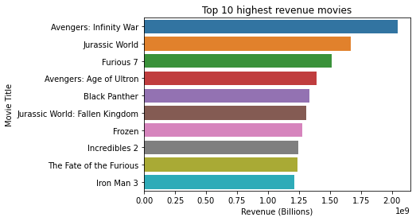
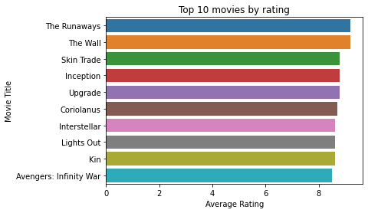

Results – Top movies
The Avengers movies was both highly rated and generated high revenue

Slide 11
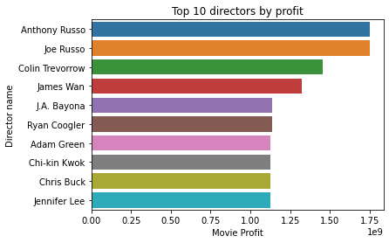
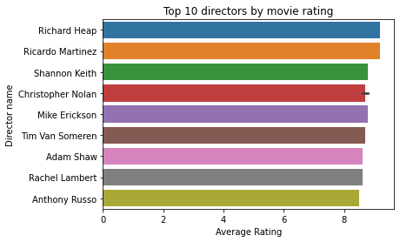
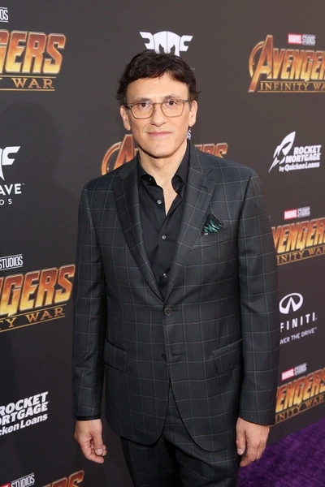
Results – Top directors
Anthony Russo is a highly rated producer whose movies are profitable

Slide 12
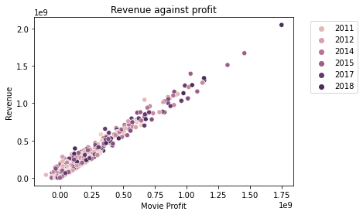
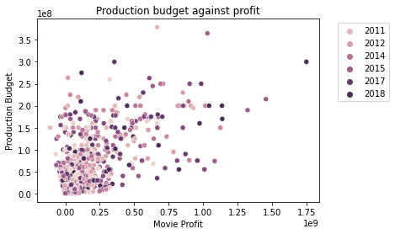
Results – Budget vs Profitability
The revenue and profitability of movies are positively correlated.
The production budget does not have a linear relationship with the profitability of the movie

Slide 13
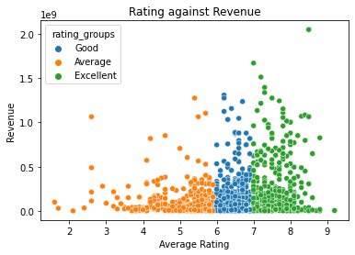
Results – Rating vs Revenue
A higher rating does not necessarily translate to a higher revenue however more movies with a higher revenue had a rating of 6 and above
Rating only do not predict the success of a movie

Slide 14
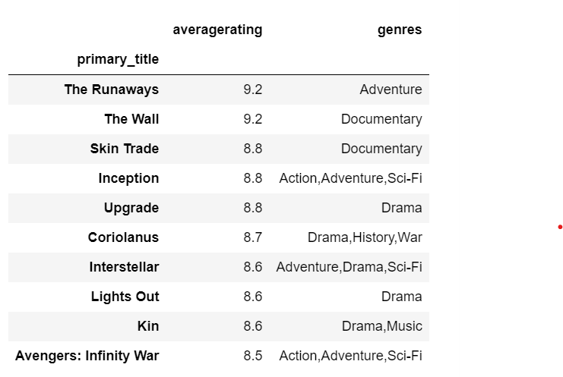
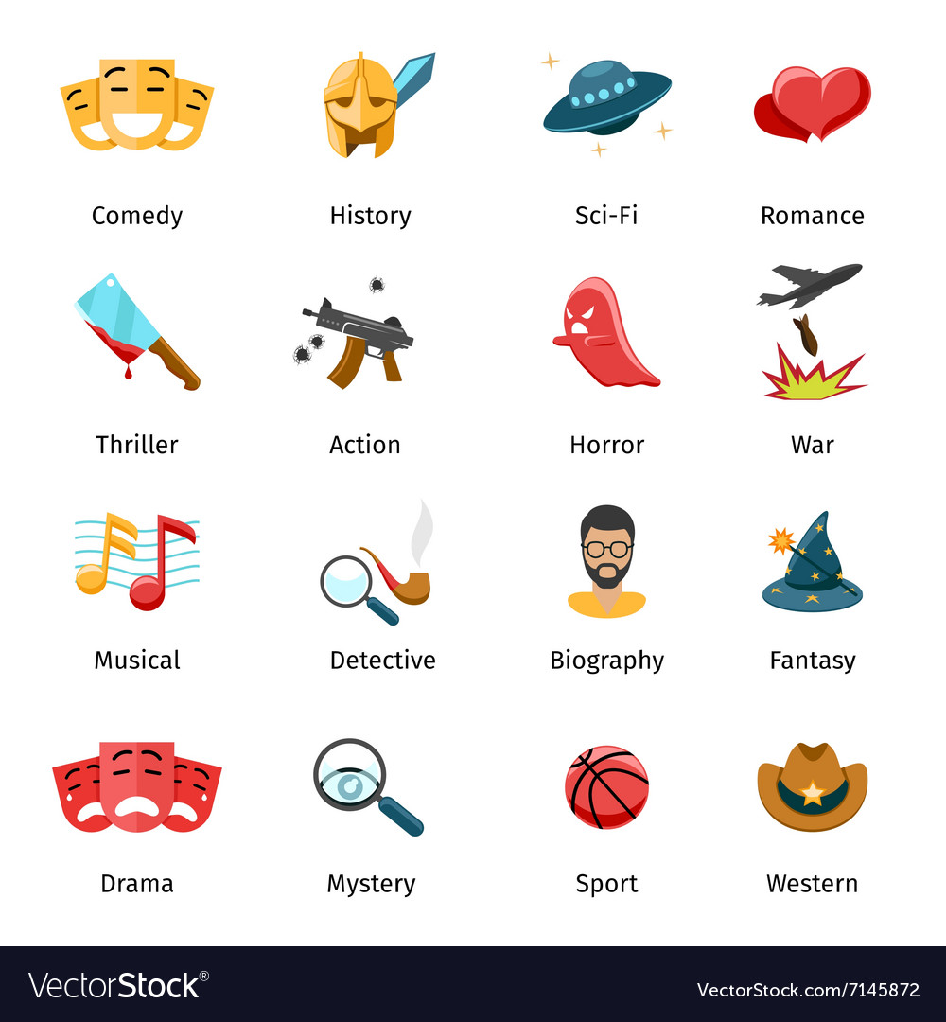
Results - Genres
Adventure and Drama movie genres are popular

Slide 15
Conclusion
I advise Microsoft to pick the top director Anthony Russo. Since he is highly rated and he produces successful movies in revenue.
He would be a great option to start off the Microsoft studio and advise in matters of choices of the genres to focus on and actors to consider.
Adventure and Drama genres are popular genres to consider
Movie business is profitable
With the right choice of directors, Microsoft will succeed in this venture

Slide 16

Email: yvonne.kirigo@gmail.com
GitHub: @KirigoY

